Slide 1


Polymorphism
in Java

Slide 2


What Is Polymorphism?
Polymorphism is the concept of one entity providing multiple implementations or behaviours. (Something like an Avatar!)

Slide 3

Peter Parker Is Polymorphic
As a high school student, Peter goes to school and hangs out with friends. As Spider Man, he bashes up baddies. Peter has multiple behaviours based on the context. Peter is polymorphic.

Slide 4

Java And Polymorphism
Java provides multiple forms of polymorphism. It allows you to define the same method name to do multiple different things. It also allows child classes to redefine/ override parents’ behaviours for the same method.

Slide 5
Java Provides 2 Types Of Polymorphism
Compile -Time Polymorphism
Polymorphism In Java
Run-Time Polymorphism

Slide 6

Compile-Time Or Static Polymorphism
Compile-time polymorphism refers to behaviour that is resolved when your Java class is compiled. Method overloading is an example of compile-time polymorphism. Method overloading is how you can use method with same name to do different things based on the parameters passed.
The add method in Class Calculator for example can add 2 integers or floats based on the types of parameters.
A calculator can add 2 integers. It can also add 2 floats. The addition method adds differently based on the inputs.

Slide 7

Illustration – Method Overloading
Public class PolymorphicCalculator
{
//Add method to add integers int add (int a, int b)
{
System.out.println(“Adding 2 Integers”); return a+b;
}
//Another Add method to add floats. Same name // differentiated by data types of parameters and // return types
The Class PolymorphicCalculator provides multiple implementation of the method add.
float add (float a, float b)
{
System.out.println(“Adding 2 Floats”); return a+b;
}
}

Slide 8
Illustration – Method Overloading
Public static void main(String args[])
{
PolymorphicCalculator calc = new PolymorphicCalculator ();
//calling the add method with integer arguments System.out.println(calc.add (3,5));
//calling the add method with float arguments System.out.println(calc.add(3.5,5.6));
}
}
Adding a main method to Polymorphic Calculator. The compiler chooses the correct add method to call based on the data types of actual arguments passed.
The output will be: Adding 2 Integers
8
Adding 2 Floats
9.1

Slide 9
Run-Time Or Dynamic Polymorphism
Run-time polymorphism refers to behaviour that is resolved when your Java class is run by the JVM. Method overriding by the sub-class is an example of run-time polymorphism.
Method overriding allows child classes to provide their own implementation of a method also defined in the parent class.
The JVM decides which version of the method (the child’s or the parent’s) to call based on the object through which the method is invoked.

Slide 10
Example
class Bike{
void run(){System.out.println("running");}
}
class Splendor extends Bike{
void run(){System.out.println("running safely with 60km");}
public static void main(String args[]){
Bike b=new Bike();
b.run();
b=new Splendor();
b.run();
}
}
Output:
Running
running safely with 60km

Slide 11
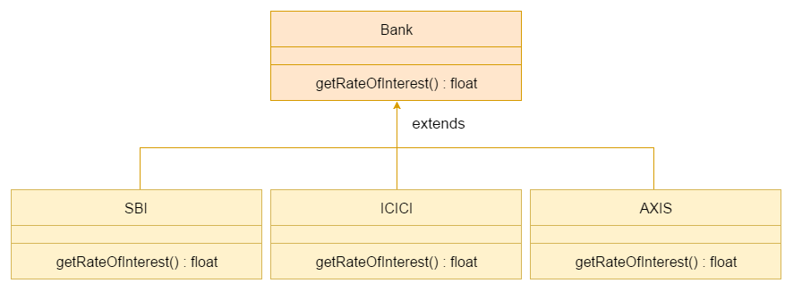
Using upcasting method

Slide 12
class Bank{
float getRateOfInterest(){return 0;}
}
class SBI extends Bank{
float getRateOfInterest(){return 8.4f;}
}
class ICICI extends Bank{
float getRateOfInterest(){return 7.3f;}
}
class AXIS extends Bank{
float getRateOfInterest(){return 9.7f;}
}
class TestPolymorphism{
public static void main(String args[]){
Bank b;
b=new SBI();
System.out.println("SBI Rate of Interest: "+b.getRateOfInterest());
b=new ICICI();
System.out.println("ICICI Rate of Interest: "+b.getRateOfInterest());
b=new AXIS();
System.out.println("AXIS Rate of Interest: "+b.getRateOfInterest());
}
}

Slide 13
Advantages Of Polymorphism
Code Cleanliness
Ease Of Implementation
Aligned With Real World
Overloaded Constructors
Reusability And Extensibility

